Slide 1
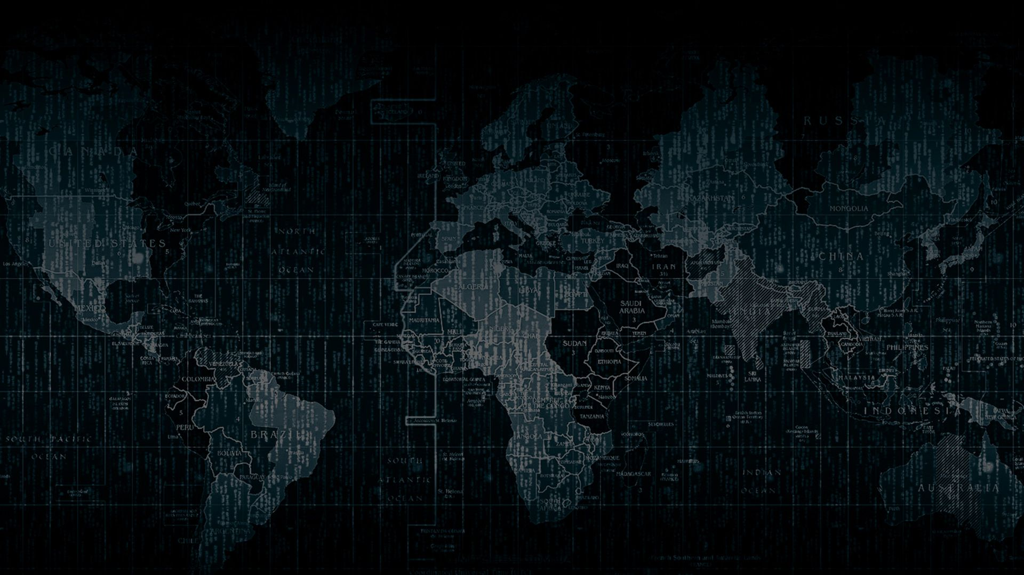

Solution By:Hoard Warriors
PSID: INTL-IVA-02
(INTL-SA-03 )
(INTL-IVA-06)(INTL-FCD-09)
(INTL-IVA-10)
Team Leader Name:SREERAM DIVYA SRI

Slide 2

Idea Introduction
IDEA TITLE- BASELINE
Tech Stack
1.Fake content detection-phishing
2.Image and video analytic
3.Data analytics
4. Cyber crime
Resources Used
1. Machine learning algo
2. Anaconda IDE
3.Python
4.Data Set
Any Third Party API/Services used
Yes
Tell us in Detail, what will be the possible outcome of your solution and how similar it is going to be in sync with actual problem statement
1.Phising,ML-fake content detection
2.Mask detection-video analytics
3. Data analytics for weather prediction
4.Image analytics-leaf disease,crop soil
5.Profit loss calculate
6.Seling crop directly
7.Water availability –data analytics
IDEA-OUTCOME – HEADLINE-

Slide 3
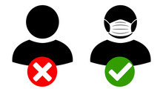
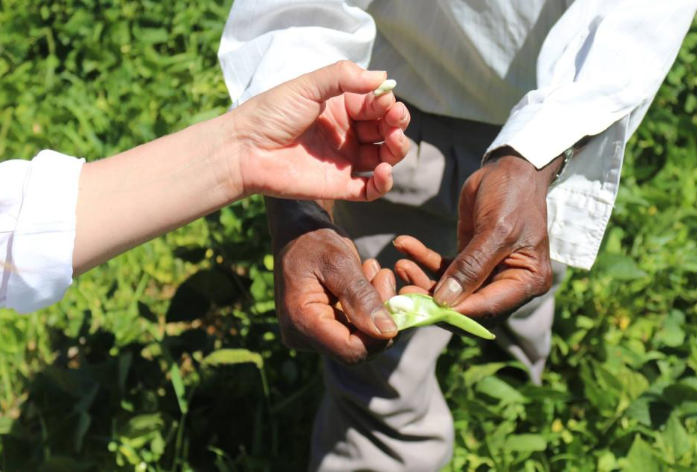
Your Approach Towards Idea
Write Your Approach in Brief below
Write your approach and Agile method(if used) in development of solution, 4 liners will be enough
How you Targetted problem?
What Innovation or feature you added
Any functional requirement in further development ?

Slide 4
How you Targeted problem
In this pandemic, hackers started targeting the users with fake cloning websites, and covid related websites So, with help of machine learning algorithm, we are detecting phishing attacks.
Due to increase in pandemic, we are trying to predict the people faces whether they have mask on their faces or not using video analytics
To predict the disease of a crop and increase the productivity of a crop we will be using image analytics
To select which crop suits for a particular soil, we will be using image analytics
To predict the weather in advance, we will be using machine learning algorithm
To predict the water availability in a particular area, we will be using data analytics

Slide 5
What Innovation or feature you added
As it a pandemic time ,we thought of detecting face masks ,if a person is not wearing face mask. The fine or imprisonment letter goes to his house. The area info will be with the office officials of that particular area. As govt always thinks In long term goal and investment. So, after this pandemic gets over, we thought of replacing the code of mask with helmet and will be using the vehicles number plate. So we will be using a flexible code. By Machine learning algorithm. We are trying to detect the fake content (Phishing),websites that are being spread at a max rate. In online in these pandemic times.
In farmers app , we are providing the weather detection using machine learning algorithm and availability of water using data analytics. Farmers can take a pic of the crop and upload it. Using image detection algorithm. We will detect what disease is the particular crop having and will be suggesting fertilizers, pesticides. By taking pic of the soil, we can detect what crops suits to the particular soil. The farmer can sell his crop directly to customer without the involvement of brokerage. We will also provide some videos for novice farmers to learn tech. In farming like crop rotation. The farmer can also calculate profit/ loss through this particular website.

Slide 6
Any functional requirement in further development ?
Cyber crime : Now this is for the covid related apps are any fake website cloning .now there may be any pirated software which takes our information without our knowledge. So for this we are doing the fake content detection to get rid of these types of phishing attacks.
Mask detection : We’ll use this Python script to train a face mask detector and review the results. We’ll use this Python script to train a face mask detector and review the results.
Detect COVID-19 face masks in images ,Detect face masks in real-time video streams
Image prediction of soil fertility and crop disease : Using image detection algorithm. We will detect what disease is the particular crop having and will be suggesting fertilizers, pesticides. By taking pic of the soil, we can detect what crops suits to the particular soil.
Weather prediction and water availability analysis : we detect weather using machine learning algorithm and availability of water using data analytics

Slide 7

Team Slide
SREERAM DIVYA SRI
(TEAM LEADER)
IMAGE ANALYTICS
AKHILESH
CYBER CRIME
NIKHIL
FAKE CONTENT DETECTION
(PHISHING)
PRANITHA
VIDEO ANALYTICS
SRAVAN
DATA ANALYTICS
SAI CHARISH
DATA ANALYTICS

Slide 8
Development Pipeline
Proposed Development Plan in pointers
1.Data analytics for water availability
2. Data analytics for weather prediction
3.Image analytics-leaf disease,crop soil
4.Profit loss calculate
5.Seling crop directly
6.phising,ML-fake content detection
7.Mask detection-image analytics
Documents To be prepared for installation and evaluation
1. Jupyter notebook-machine learning
2.Vs Studio-web Development
3.Data Analytics, image and video analytics- Matlab
4.phising-
Anaconda
Any Third party API used,i if yes please specify
YES
API Weather key
Repository Link or Any refrences link of folders
https://github.com/DIVYASRI1881/
Proposed UI and functional flow in pointers
1.
2.
3.
4.
5.
Step A
Step B
Step C
Step D
Step E

Slide 9
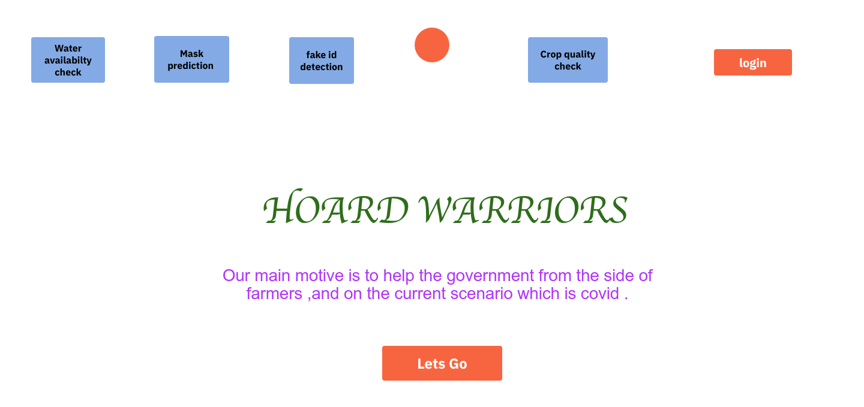
Proposed UI and functional flow in pointers

Slide 10


Slide 11
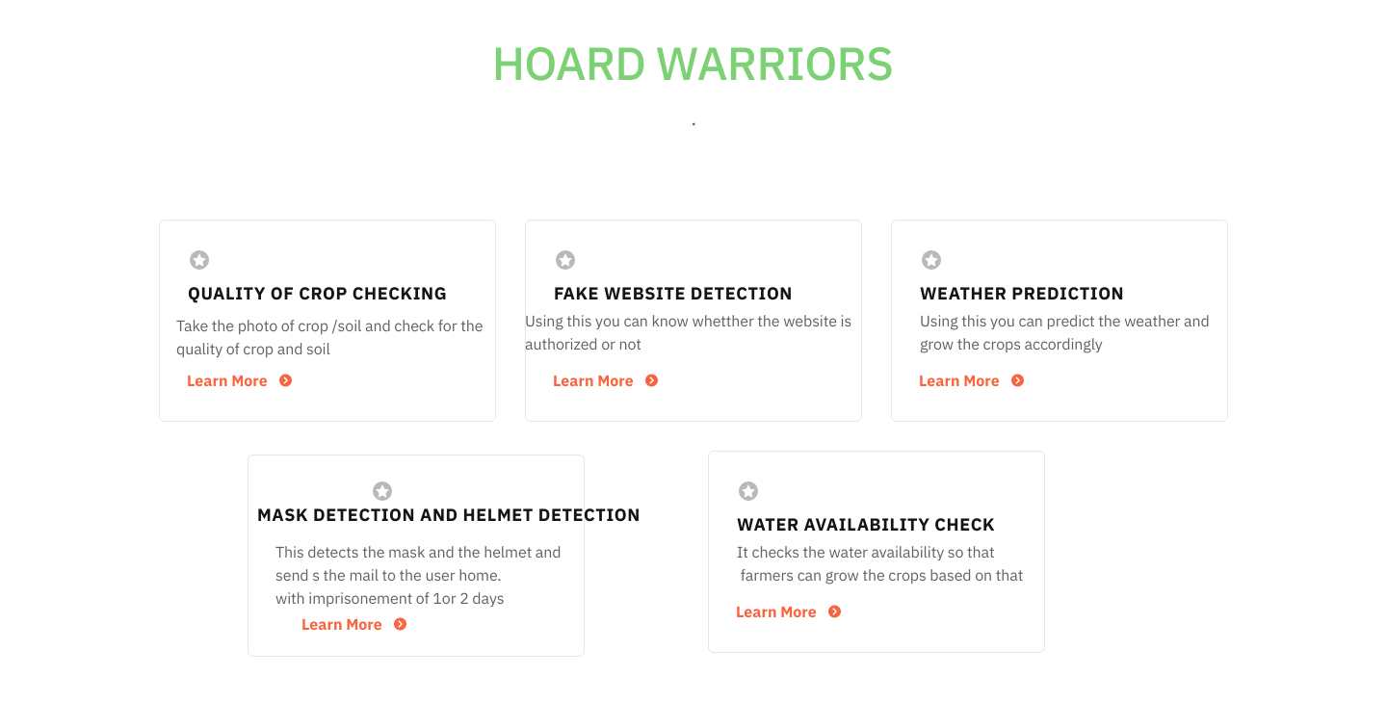

Slide 12
Vision of Innovation/Idea/Solution
How you idea is different and innovative form other ideas-
Explain How you developed Idea
How much time it will take in conversion as a final product
Any early stage innovation detected while developing the solution

Slide 13
Explain How you developed Idea
We used image Analytics to develop and detect plant disease and detecting which crop suits to particular soil. We developed it using python
We developed code in machine learning algorithm to detect the weather availability in a particular area
Video analytics for mask detection
We developed code for fake content detection using Machine learning algorithm to stop phishing

Slide 14
How much time it will take in conversion as a final product
1.Data analytics for water availability - 9 hours
2. Data analytics for weather prediction - 11 hours
3.Image analytics-leaf disease, crop soil -20 hours
4.Profit loss calculate -5 hours
5.Seling crop directly -8 hours
6.phising,ML-fake content detection -17 hours
7.Mask detection-video analytics -28 hours
8. Integration of all features - 32 hours
--------------
TOTAL TIME TAKEN 21 days (approx.)
--------------

Slide 15
How your idea is different and innovative form other ideas-
We are providing the weather detection using machine learning algorithm and availability of water checking using data analytics for farmers. Using image detection algorithm Farmers can take a pic of the crop and upload it.
using image detection algorithm. we will detect what disease is the particular crop having and will be suggesting fertilizers, pesticides.
by taking pic of the soil, we can detect what crops suits to the particular soil .
we will also provide some videos for novice farmers to learn tech.
in farming like crop rotation.
The farmer can also calculate profit/ loss through this particular website.
The area info will be with the office officials of that particular area. If a person is not wearing a mask. The fine or imprisonment will be sent to the particular office or officials,
By phishing we are going to detect the fake content that are spreading more in these times

Slide 16
Any early stage innovation detected while developing the solution
1.Data analytics for water availability
2. Data analytics for weather prediction
3.Image analytics-leaf disease, crop soil
4.Profit loss calculate
5.Seling crop directly
6.Phising- Fake content detection
7.Mask detection- image , video analytics

